Slide 1


Lecture 3:
Integrated assessment of climate change and sustainable development
Open-Source Energy System Modeling
TU Wien, VU 370.062
Dipl.-Ing. Dr. Daniel Huppmann

Slide 2
Required reading and preparation
SENSES Scenario Primer: www.climatescenarios.org/primer
D. Huppmann et al. (2018). A new scenario resource for integrated 1.5 °C research.
Nature Climate Change, 8:1027-1030. doi: 10.1038/s41558-018-0317-4
  Paywall-free access at rdcu.be/9i8a

Slide 3
The use of scenarios for policy analysis and the Intergovernmental Panel on Climate Change (IPCC)
Part 1

Slide 4
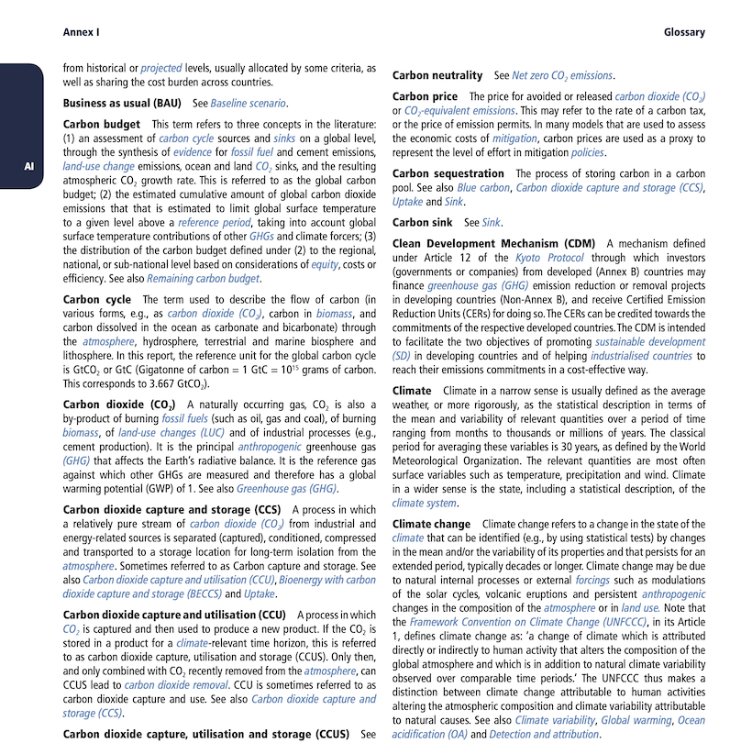
A definition of climate change
The term climate change is about mean & variability and human activity
The Glossary – Annex 1 of the IPCC
Special Report on Global Warming of 1.5°C (SR15).
Climate change Climate change refers to a change in the state of the climate that can be identified (e.g., by using statistical tests) by changes in the mean and/or the variability of its properties and that persists for an extended period, typically decades or longer. Climate change may be due to natural internal processes or external forcings such as modulations of the solar cycles, volcanic eruptions and persistent anthropogenic changes in the composition of the atmosphere or in land use. Note that the Framework Convention on Climate Change (UNFCCC), in its Article 1, defines climate change as: ‘a change of climate which is attributed directly or indirectly to human activity that alters the composition of the global atmosphere and which is in addition to natural climate variability observed over comparable time periods.’

Slide 5
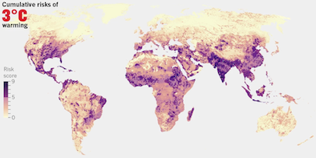
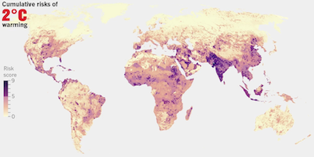
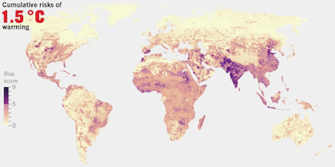
The impacts of climate change
Increasing temperatures exposes billions
to multi-sector risks
Millions of people exposed
Source: “The hard truths of climate change — by the numbers“ (Nature 573:324, September 19, 2019)
based on Byers et al. (2019, doi: 10.1088/1748-9326/aabf45)

Slide 6



The ”policy background” of climate change and sustainable development
Two landmark agreements in 2015 define the (research) agenda
“Transforming our world: the 2030 Agenda for Sustainable Development” was adopted
at the United Nations Sustainable Development Summit on 25 September 2015.
They comprise 17 Sustainable Development Goals (SDG) and 169 targets,
which are measured with 232 indicators.
The „Paris Agreement“ was negotiated at the 21st Conference of the Parties (COP21)
of the UNFCCC in Paris and adopted by consensus on 12 December 2015.
It aims to keep global warming to “well below 2 °C” compared to pre-industrial levels
while also to "pursue efforts to" limit the temperature increase to 1.5 °C.

Slide 7
Definition of terms
It’s a challenge to talk about the future...
There are numerous terms and concepts
  A forecast is based on assumptions of what is considered to occur most likely in the future
  A projection is based on hypothetical assumptions
  A scenario is a counterfactual development, usually compared to a baseline
  A pathway is a numerical evaluation of scenarios/projections combined with a narrative
Another way to think about this question: A scenario allows us to ask “what if” questions…
  Unfortunately, these definitions are just one possible set of usages.
  So beware, there is no consistent use of these terms in policy debate or scientific research!

Slide 8
The “hierarchy” of models and scenarios
It’s not quite obvious what we mean by “climate scenario”
The physical science basis: greenhouse gas concentration & radiative forcing
      The Representative Concentration Pathways (RCP)
Stylized climate models: emissions timeseries & temperature
Integrated Assessment Models (IAM): “optimal” balance between economy and mitigation
      Usually called “cost-benefit IAMs”
      Most famous example: the DICE model, 2018 Nobel Prize for William Nordhaus
Integrated Assessment Models (IAM): “optimal” transition pathway given a mitigation target
      Sometimes called “process-ased IAMs”
      The Shared Socio-Economic Pathways (SSPs)
    If you’re wondering about the difference between the two classes of IAMs:
    https://www.carbonbrief.org/qa-how-integrated-assessment-models-are-used-to-study-climate-change
Scenarios to analyze impacts and adaptation needs (that’s yet a different class of models)

Slide 9
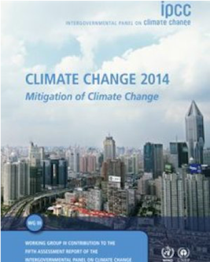
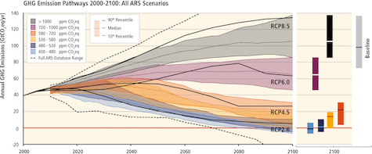
The Representative Concentration Pathways (RCP)
Reference climate futures categorized by “radiative forcing”
In IPCC AR5, scenarios were categorized by their radiative forcing
at the end of the century as a proxy for temperature
This yields a range of emissions trajectories consistent with each RCP
IPCC, 2014: Climate Change 2014:
Mitigation of Climate Change.
Contribution of Working Group III
to the Fifth Assessment Report (AR5)
Pathways of global GHG emissions in baseline and mitigation scenarios
IPCC AR5 WG3 SPM.4 (Panel a)

Slide 10
The Shared Socioeconomic Pathways (SSPs)
The SSPs allow to analyse climate policy relative to alternative futures
SSPs represent different futures
assuming no climate policy
Each SSP has distinct assumptions about
external drivers like population & GDP
Multiple IAMs implement all SSPs
  See Riahi et al. (2016) and
  Rogelj et al. (2017) for details
Not all SSP implementations are compatible with different levels of climate ambition
Schematic illustration of main steps in developing the SSPs,
Fig. 1, O’Neill et al. (2017)

Slide 11
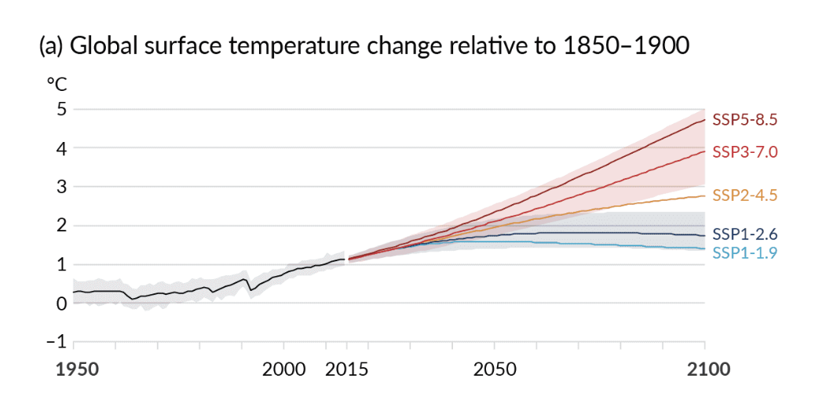
Combining RCPs and SSPs
In the IPCC AR6 report, scenarios combining an SSP storyline
and a RCP “climate ambition level” were used as benchmarks
The name of the scenarios combine
the SSP storyline (which assumes no climate policy) and the RCP target value (representing the ambition level of climate policy measures)
Global surface temperature change by RCP-SSP, IPCC AR6 WG1, SPM 8, Panel a

Slide 12
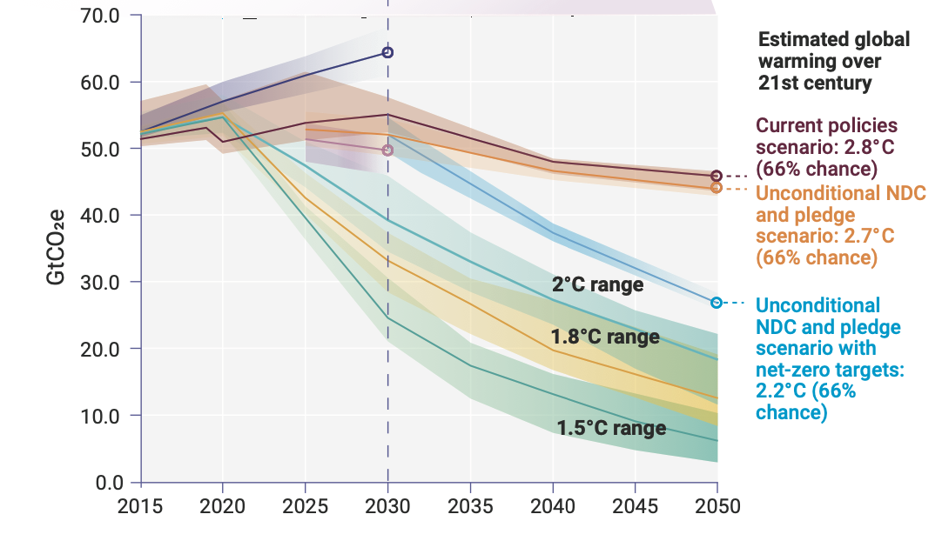
The gap between current policies and pledges to reduce emissions
Where do we stand in terms of (promised) emissions reductions?
Figure ES.6, UN Emissions Gap Report, 2021

Slide 13
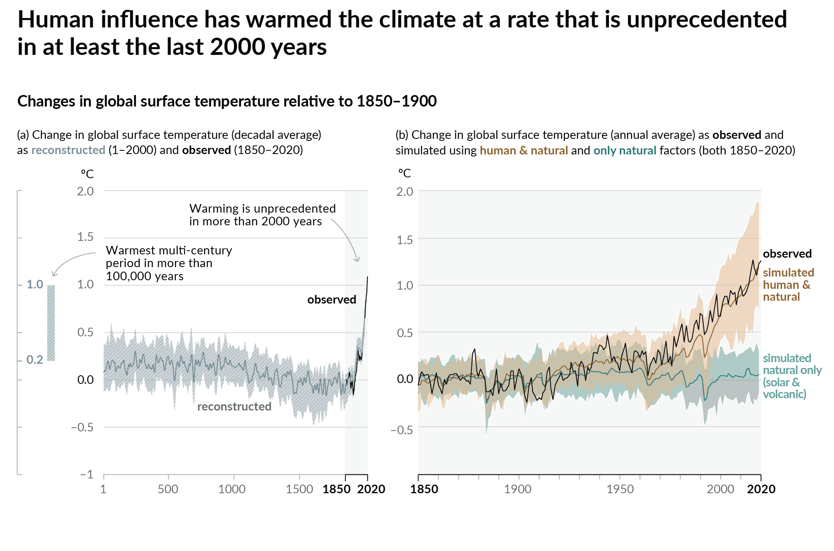
Historical temperature range and expected future heating
We are leaving the temperature range of human civilization
°C
3.0
Expected temperature increases based on
currently implemented policies
2.5
Expected temperature increase based on announced policies (“pledges”)
2.0
1.5
Goal of the Paris Agreement
1.0
Historical global average temperature | IPCC AR6 WG1 SPM 1a
Stylized representation
of expected temperature increases based on
https://twitter.com/ClimateRsrc/status/1592084718321041409

Slide 14
Definition of terms (2)
Many scenarios used in the IPCC assessment come from process-based IAMs
Process-based Integrated Assessment Models (IAM)
  Numerical tools to (primarily) evaluate scenarios of climate change mitigation
  They combine detailed representations of the human system (energy, economy)
  and the earth system (climate, oceans), including land use (and land use change)
  There is a broad range of methodological concepts underlying various IAMs,
  including (energy-system++) optimization, economic equilibrium (CGE), system dynamics

Slide 15

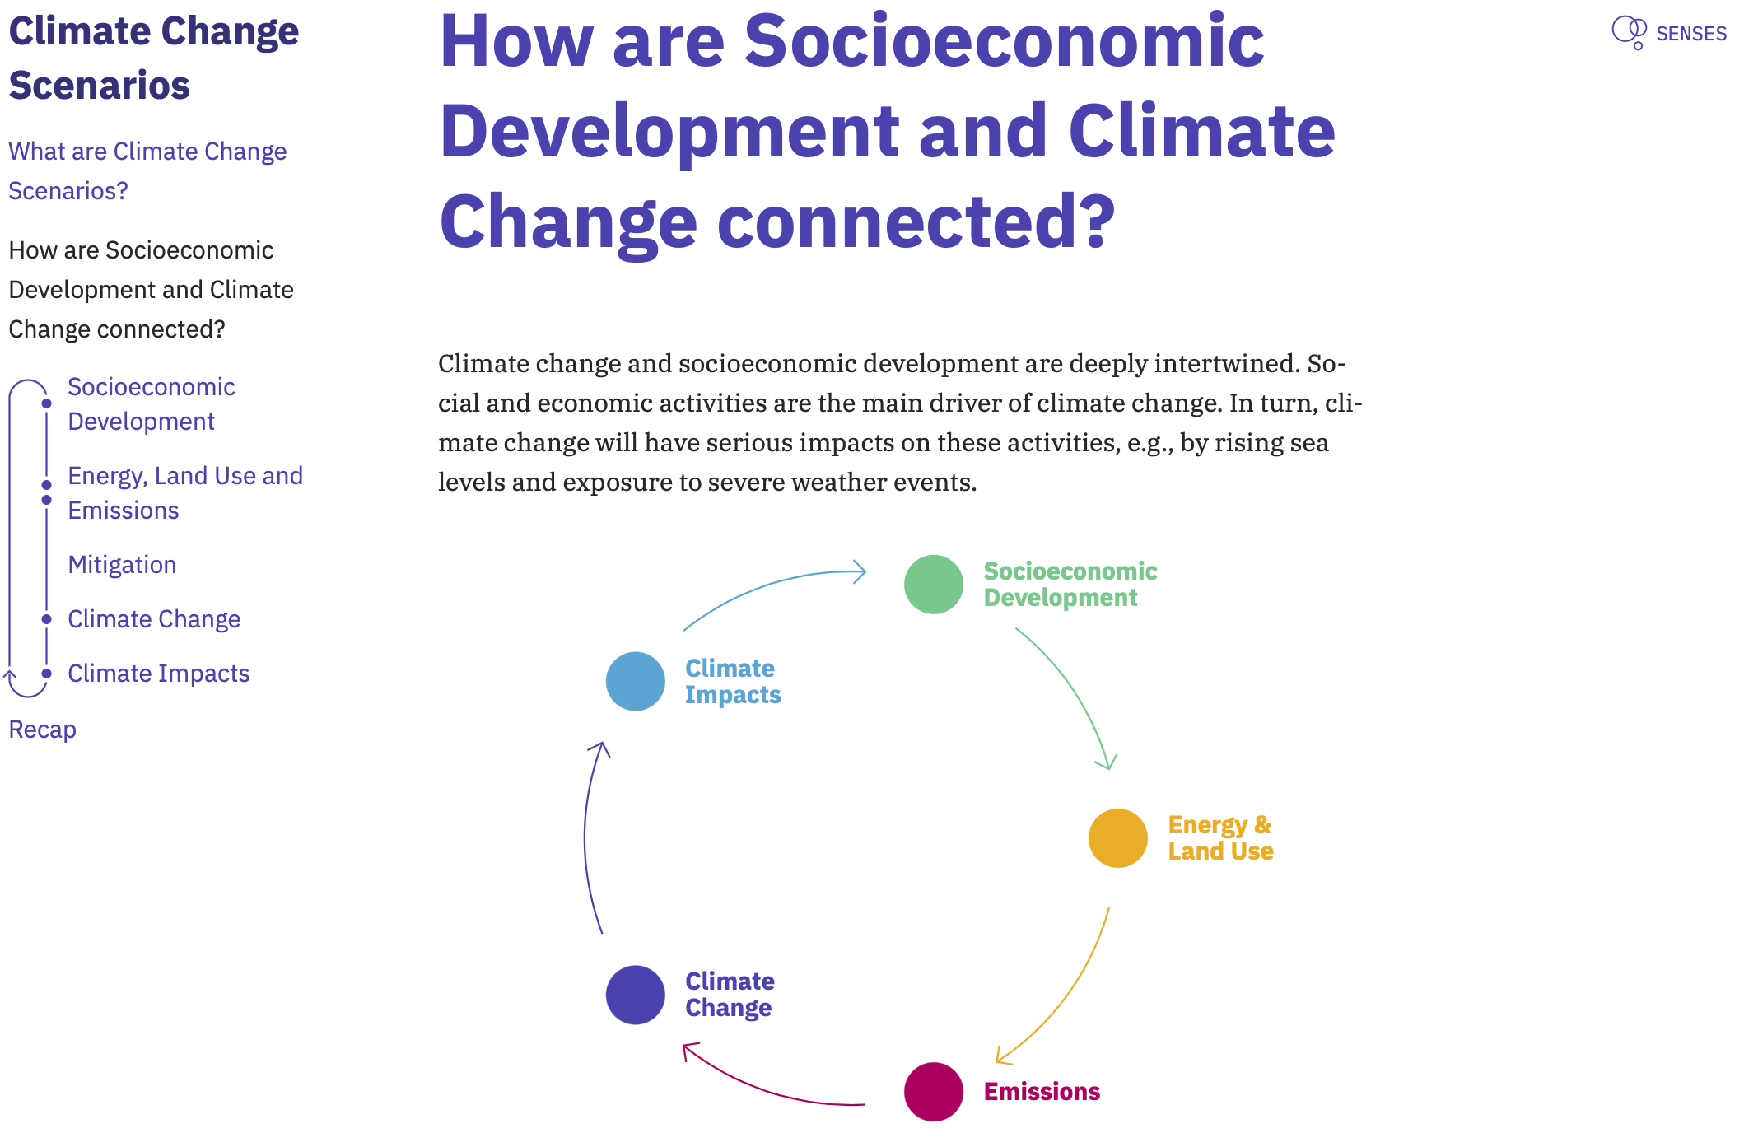
A scenario primer
How can we use model-based scenarios to understand sustainable development?
The aim of SENSES is to generate tools for debate and deliberation of scenarios in the context of climate change mitigation and adaptation.
The interactive approach of co-production prevents that users become detached from the original scenario data, and minimizes the risk that information is misinterpreted and/or perceived as intransparent.
The Scenario Primer is the first in a suite of open tools developed in the SENSES project (senses-project.org).
See www.climatescenarios.org/primer for more information

Slide 16
Criticisms of numerical (integrated assessment) models (I)
There are many contentious aspects about numerical models
of the economy-energy-environment-climate system
Frequent criticisms of large-scale numerical models for climate change
Closed and intransparent ’black box’ models
  Very sensitive to implicit assumptions and modeling artefacts
Over-optimistic assumptions on technological progress
  Assume availability of technologies like CCS, hydrogen economy
Use of discount rates: what’s the correct valuation of the future?
Not sufficiently focused on human development (too technocratic)
Virtually impossible to verify (projections of) input assumptions
  In contrast to climate models, where “backcasting” is frequently applied
“There is group-think in the modelling community”

Slide 17
Criticisms of numerical (integrated assessment) models (II)
More importantly, projections based on numerical models
may create a false impression of certainty and inevitability
  “IAM-based analyses of climate policy create a perception of knowledge
  and precision that is illusory, and can fool policy-makers into thinking
  that the forecasts the models generate have some kind of scientific legitimacy.”
  Robert S. Pindyck. "The Use and Misuse of Models for Climate Policy”.
  National Bureau of Economic Research (NBER),
  Working Paper No. 21097, 2015. doi: 10.3386/w21097

Slide 18
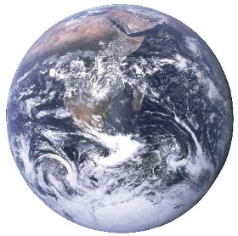



The big picture of IPCC assessments
The interaction between the human and earth systems
Physical Climate System
Scope of IPCC assessments
    Time scales:
      Paleoclimate to 2300 and beyond
    Spatial scales:
      Global to local
    Rates of change:
      Climatic & socio-economic developments
    Risks:
      To humans and ecosystems
Humans and Ecosystems
Based on lecture slides by Matthew Robbins, https://bit.ly/2Z3XJrt, presented at EGU 2019

Slide 19
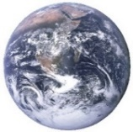







The big picture of IPCC assessments
The interaction between the human and earth systems
Physical Climate System
Hazards
Climate forcing
& processes
Risks
Adaptation
Mitigation
Emissions
Humans and Ecosystems
Impacts
Based on lecture slides by Matthew Robbins, https://bit.ly/2Z3XJrt, presented at EGU 2019

Slide 20
The role and structure of the IPCC
The IPCC provides policymakers with assessments of climate change,
its implications and risks, and to put forward adaptation & mitigation options
The scientific assessment by the IPCC is structured in three working groups
Working Group I – The Physical Science Basis
      WG I assesses the physical science of climate change.
Working Group II – Impacts, Adaptation and Vulnerability
      WG II assesses the vulnerability of socio-economic and natural systems to climate change,
      negative and positive consequences of climate change and options for adapting to it.
Working Group III – Mitigation of Climate Change
      WG III focuses on climate change mitigation, assessing methods for reducing greenhouse gas emissions, and removing greenhouse gases from the atmosphere.
For each assessment report, a Synthesis Report is produced from the three WG contributions
Each contribution and the synthesis report has a “negotiated” Summary for Policy Makers

Slide 21
Principles of assessment by the IPCC
The IPCC assesses the state of knowledge in the scientific literature;
reports aren’t policy-prescriptive, but provide information to decisionmakers
The IPCC assesses available scientific, technical and socio-economic literature relevant to understanding the scientific basis of climate change
  Published in peer-reviewed journals or eligible grey literature (e.g. IEA reports)
  In most cases, it is sufficient to extract relevant information, findings
  or data from manuscripts or reports
But relying only on published manuscripts & supplementary material
for quantitative scenarios across studies is challenging
  Numerical results are not presented in the same data format
  Only a selection of numerical results presented in manuscript and SM
  e.g., only indicators of interest in relation to the research question
  Definitions and units differ across models and studies

Slide 22

Collaboration between IPCC and the integrated assessment community
Over the past decade, the IPCC collaborated with the umbrella organization
of global modelling teams to compile structured scenario ensembles
Adapted from Figure 2, Cointe, Cassen and Nadaï, Science & Technology Studies (forthcoming)
sciencetechnologystudies.journal.fi/forthcoming/article/65031/40929

Slide 23
A consolidated scenario resource for the IPCC assessment
Part 2

Slide 24



The IAMC template for timeseries data
A community effort for compiling and sharing scenario results
Over the past decade, the integrated-assessment community (IAMC) developed a tabular data format used for model inter-comparison projects
  High-profile use case: IPCC Fifth Assessment Report (AR5)
  see https://tntcat.iiasa.ac.at/AR5DB/
  Used by ~50 research teams around the world, for model inter-comparison projects, etc.
It’s not a great standard...
  No metadata, no sub-annual time resolution, bad scalability, ...
  But it’s easy to work with for non-experts, across platforms, ...
  And it’s the format we are stuck with in the IAM community...
 | A | B | C | D | E | F | G | H | I
1 | Model | Scenario | Region | Variable | Unit | 2005 | 2010 | 2015 | 2020
2 | MESSAGE | CD-LINKS 400 | World | Primary Energy | EJ/y | 454.5 | 479.6 | ... | ...
Notes:
FAIR: Interoperable

Slide 25

A scenario database for the IPCC AR5
For AR5, the IPCC, IAMC and IIASA compiled a database
to underpin the assessment of quantitative scenarios
For the IPCC’s Fifth Assessment Report (AR5), Working Group III,
the Integrated Assessment Modeling Consortium (IAMC) and IIASA
collaborated to compile a database of quantitative scenarios
This resource was used for the consistent assessment
of emission pathways and system transitions in AR5
IPCC, 2014: Climate Change 2014:
Mitigation of Climate Change.
Contribution of Working Group III
to the Fifth Assessment Report
Figure SPM.4 (Panel a) | Pathways of global GHG emissions (GtCO2eq/yr) in baseline and mitigation scenarios

Slide 26
Caveats of the IPCC AR5 scenario assessment
The AR5 scenario database (2014) was a valuable resource for research,
but it didn’t follow current best-practice principles of open science
Measures to ensure transparency of the assessment and underlying data:
    Database publicly available for view and download: tntcat.iiasa.ac.at/AR5DB/
    Documentation of the scenarios:
    Krey, V., Masera, G., et al., 2014, Annex II: Metrics & Methodology. In: Climate Change 2014: Mitigation of Climate Change. Contribution of Working Group III to the Fifth Assessment Report
    Description of figure generation methods in supplementary material of the AR5
Shortcomings of the AR5 database in terms of usability and transparency:
      Scenario database is not state of the art for interactive web pages
      No intuitive citation for the data, and no acknowledgment for modelling teams as Annex or data authors (only references to their studies)
      Considerable effort required to reproduce figures and tables
      Treatment of scenario database as statistical sample by some researchers

Slide 27
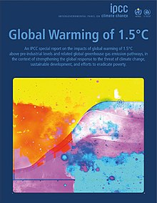
A new integrated 1.5°C scenario resource
For SR15 (2018), we wanted to go one step beyond the efforts in AR5
for more transparency and reproducibility of the assessment
An interactive scenario explorer launched for the SR15:
  data.ece.iiasa.ac.at/iamc-1.5c-explorer
Assessment and generation of figures & tables using open-source notebooks
  Categorization of scenarios for the assessment was
  implemented by the Chapter Scientist for the authors
  Development of the Python package pyam for analysis and visualization
Description of the process of compiling and assessing
the scenario ensemble, including “do’s and don’ts”
  Commentary published in Nature Climate Change
Documentation of modelling frameworks and scenarios
  Details in the online scenario explorer and in an SR15 Annex
SR15, IPCC, 2018

Slide 28
Scenario categorization for the SR15
The scenarios collected in the ensemble were categorized
by their end-of-century (expected) warming and “temperature overshoot”
Category | Subcategory | Probability | Number
Below 1.5°C | Below 1.5°C (I) | P1.5°C ≤ 0.34 | 0
 | Below 1.5°C (II) | 0.34 < P1.5°C ≤ 0.50 | 9
1.5°C return with low overshoot | Lower 1.5°C | 0.50 < P1.5°C ≤ 0.67 and P1.5°C(2100) ≤ 0.34 | 34
 | Higher 1.5°C | 0.50 < P1.5°C ≤ 0.67 and 0.34 < P1.5°C(2100) ≤ 0.50 | 10
1.5°C return with high overshoot | Lower 1.5°C | 0.67 < P1.5°C and P1.5°C(2100) ≤ 0.34 | 19
 | Higher 1.5°C | 0.67 < P1.5°C and 0.34 < P1.5°C(2100) ≤ 0.50 | 18
Lower 2.0°C |  | P2.0°C ≤ 0.34 (excluding above) | 74
Higher 2.0°C |  | 0.34 < P2.0°C ≤ 0.50 (excluding above) | 58
Above 2.0°C |  | P2.0°C > 0.50 during at least 1 year | 189
Based on Table 2.A.11, IPCC SR15, www.ipcc.ch/sr15/

Slide 29
The do’s & don'ts of scenario ensemble analysis
The scenarios form an unstructured “ensemble of opportunity”,
so one must be careful when drawing conclusions from the data
The scenarios were not designed to explore all possible developments;
instead, they were compiled from a range of studies and reports.
  Don’t interpret the scenario ensemble as a statistical sample
  or in terms of likelihood or agreement in the literature.
  Don’t focus only on the medians, but consider the full range over the scenario set.
  Don’t cherry-pick individual scenarios to make general conclusions.
  Don’t over-interpret scenario results and don’t venture too far
  from the original research focus.
  Don’t conclude that the absence of a particular scenario
  (necessarily) means that this scenario is not feasible or possible.
Quoted from Box 1, Huppmann et al. (2018), Nature Climate Change 8:1027-1030. doi: 10.1038/s41558-018-0317-4

Slide 30
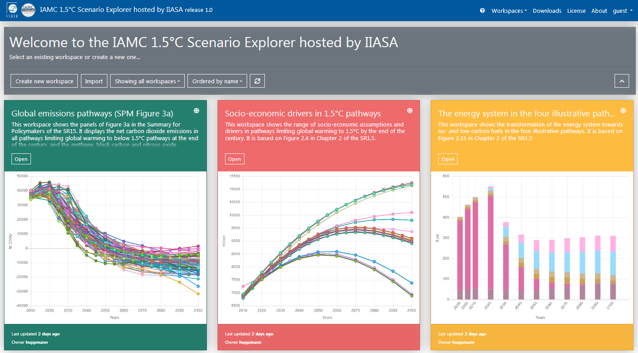
The IAMC 1.5°C Scenario Explorer
Using predefined “workspaces” replicating SR15 figures for easy access
Visit the IAMC 1.5°C Scenario Explorer at https://data.ene.iiasa.ac.at/iamc-1.5c-explorer
Notes:
FAIR: Accessible

Slide 31
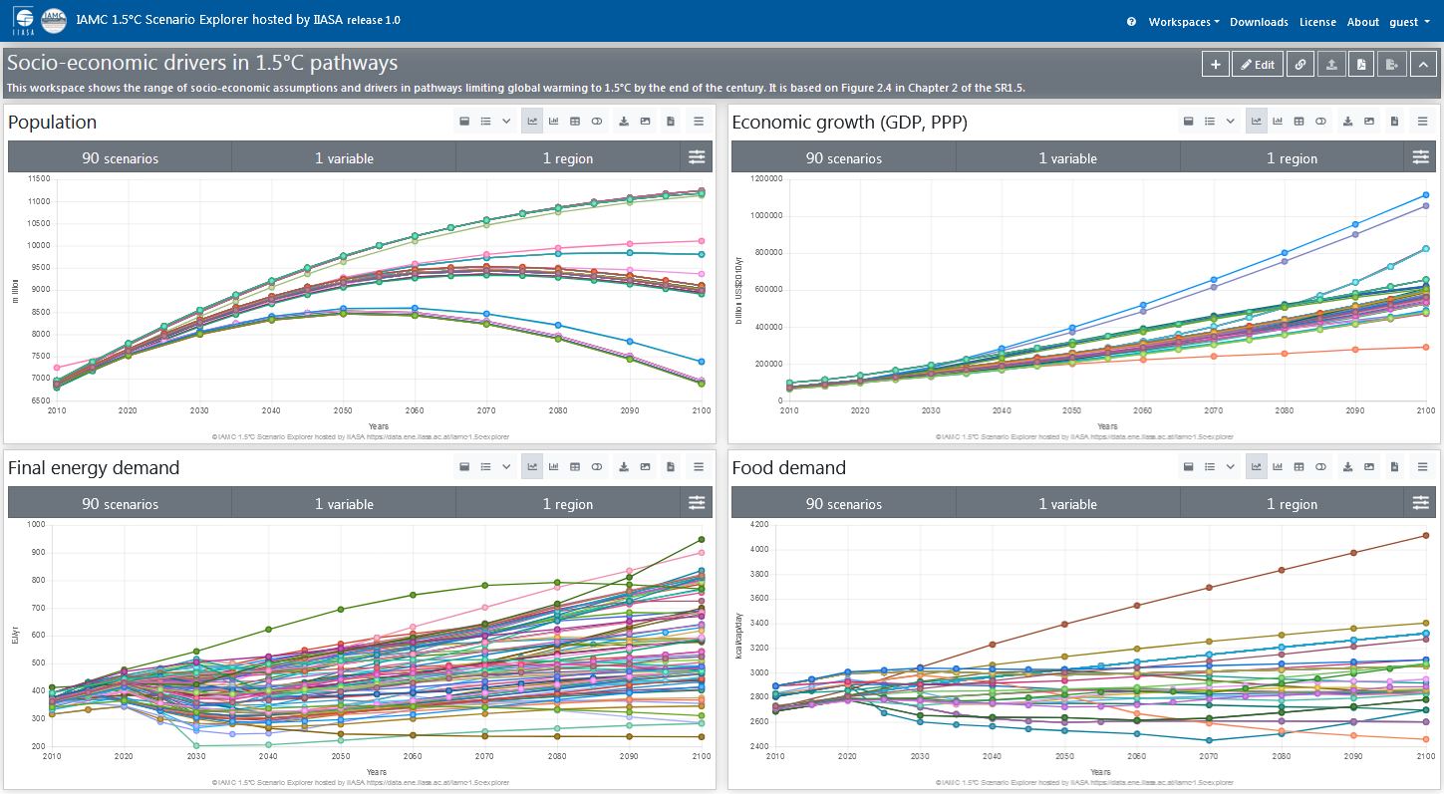
The IAMC 1.5°C Scenario Explorer
Socio-economic drivers across 1.5°C pathways (SR15 Figure 2.4)
Visit the IAMC 1.5°C Scenario Explorer at https://data.ene.iiasa.ac.at/iamc-1.5c-explorer

Slide 32
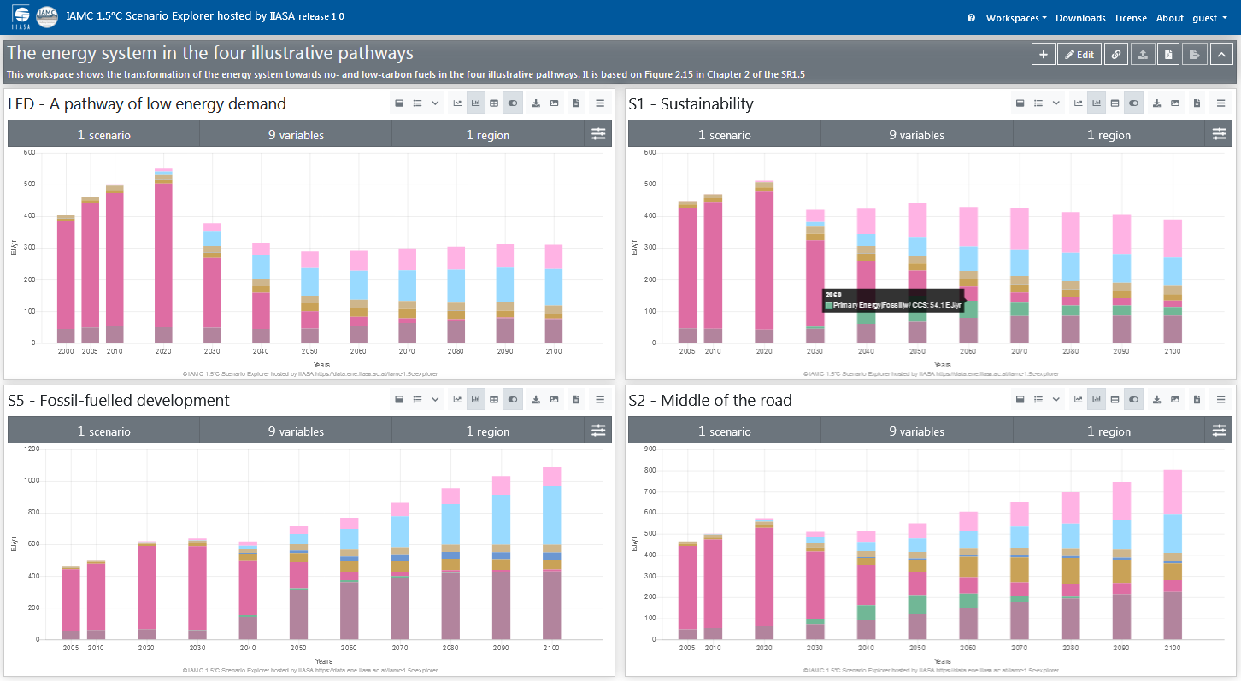
The IAMC 1.5°C Scenario Explorer
Energy system transition in four illustrative pathways (SR15 Figure 2.15)
Visit the IAMC 1.5°C Scenario Explorer at https://data.ene.iiasa.ac.at/iamc-1.5c-explorer

Slide 33
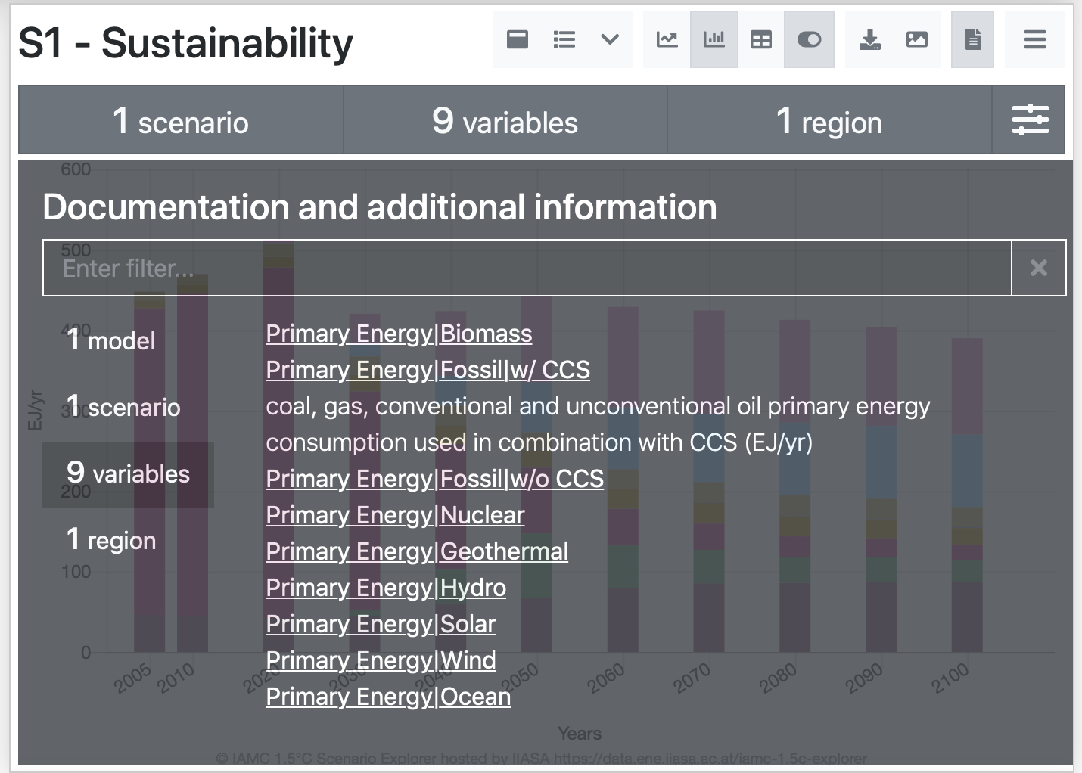
IAMC 1.5°C Scenario Explorer
The scenario explorer includes documentation of models, scenarios & variables
Visit the IAMC 1.5°C Scenario Explorer at https://data.ene.iiasa.ac.at/iamc-1.5c-explorer

Slide 34
A Python package for analysis and visualization of Integrated Assessment timeseries data
Part 3

Slide 35
Comparing figures in the IAMC 1.5°C Scenario Explorer to the SR15
Socio-economic drivers across 1.5°C pathways in the Scenario Explorer and the SR15 (Figure 2.4)
Range of assumptions in the predefined Scenario Explorer workspace and the SR15 (Figure 2.4, page 111)

Slide 36
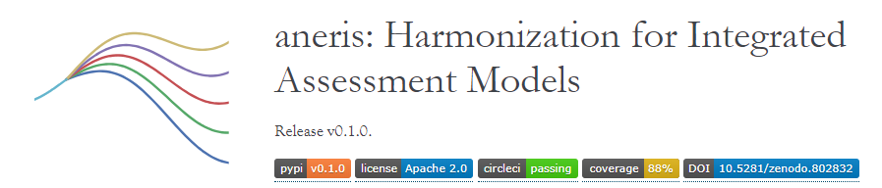
The pyam package for IAM analysis & visualization
Joining forces across applications to develop a Python package
Harmonization and visualization of emissions pathways in IAMs
  aneris for IAM harmonization: software.ene.iiasa.ac.at/aneris
  pyam for plotting & visualization
    Scientific reference:
      Matthew J. Gidden et al. (2018) A methodology and
      implementation of automated emissions harmonization for use in IAMs.
      Environmental Modelling & Software 105:187-200. doi: 10.1016/j.envsoft.2018.04.002
Scenario assessment for the IPCC “Special Report on 1.5°C” (SR15)
  Completeness checks, data consistency validation, categorization
  Statistical analysis on filtered data and plotting figures for report
  Assessment and figures published together
  with the full report for transparency and reproducibility
  Implemented using best-practice of open, collaborative scientific software development
Notes:
FAIR: Interoperable

Slide 37
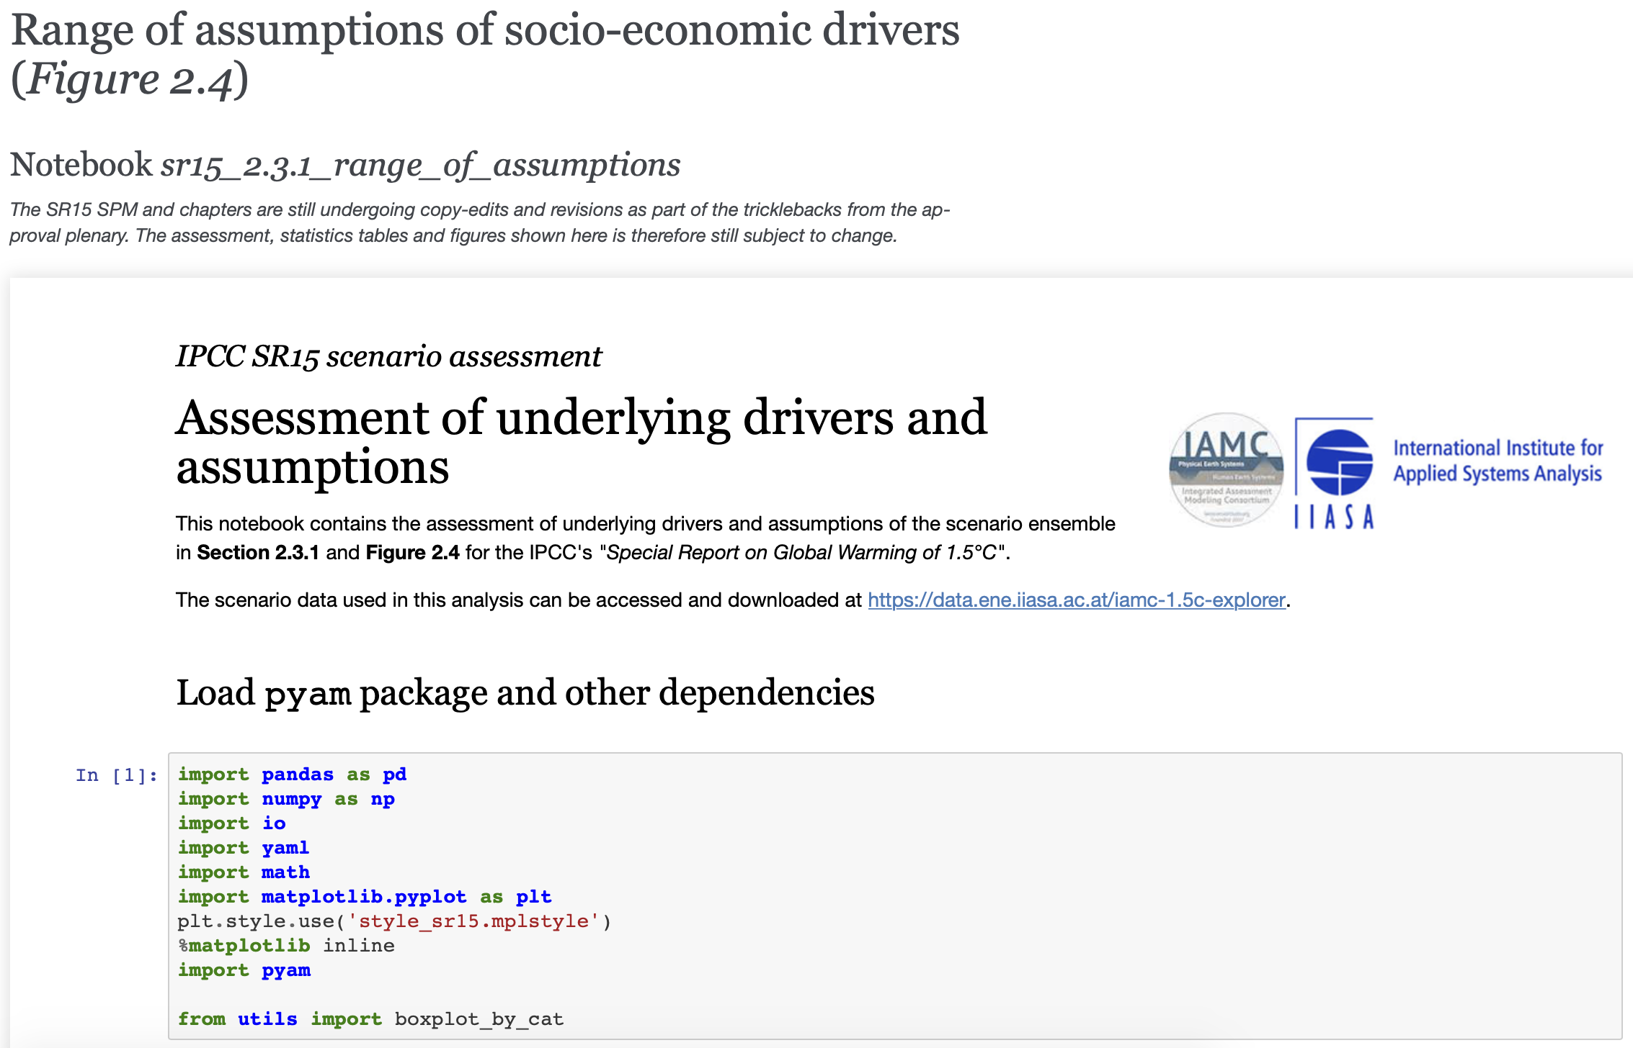
Scenario assessment for the IPCC
The scenario validation, categorization by warming outcome,
and many SR15 tables and figures were implemented with pyam
See all notebooks in a rendered format at data.ene.iiasa.ac.at/sr15_scenario_analysis

Slide 38
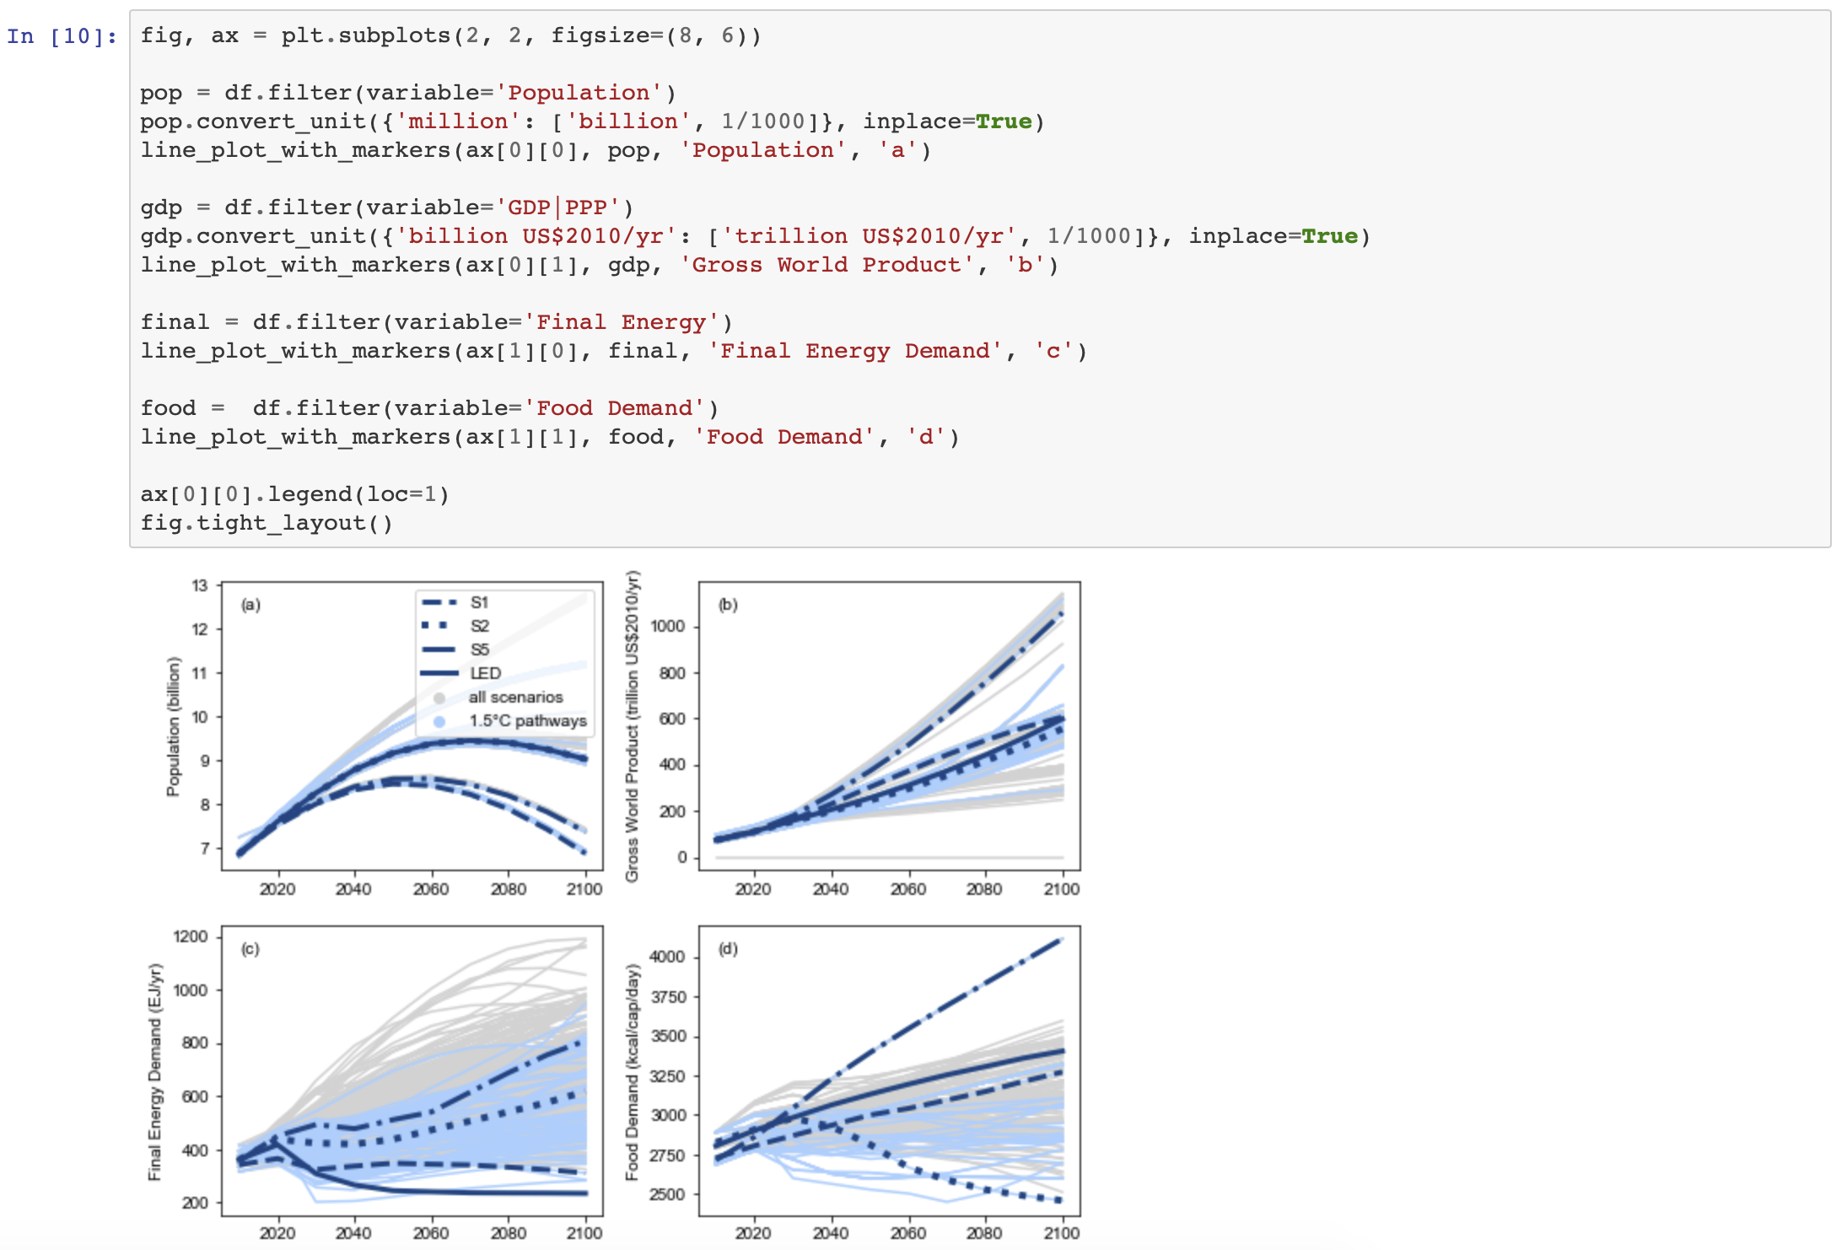
Scenario assessment for the IPCC
The scenario validation, categorization by warming outcome,
and many SR15 tables and figures were implemented with pyam
See all notebooks in a rendered format at data.ene.iiasa.ac.at/sr15_scenario_analysis

Slide 39
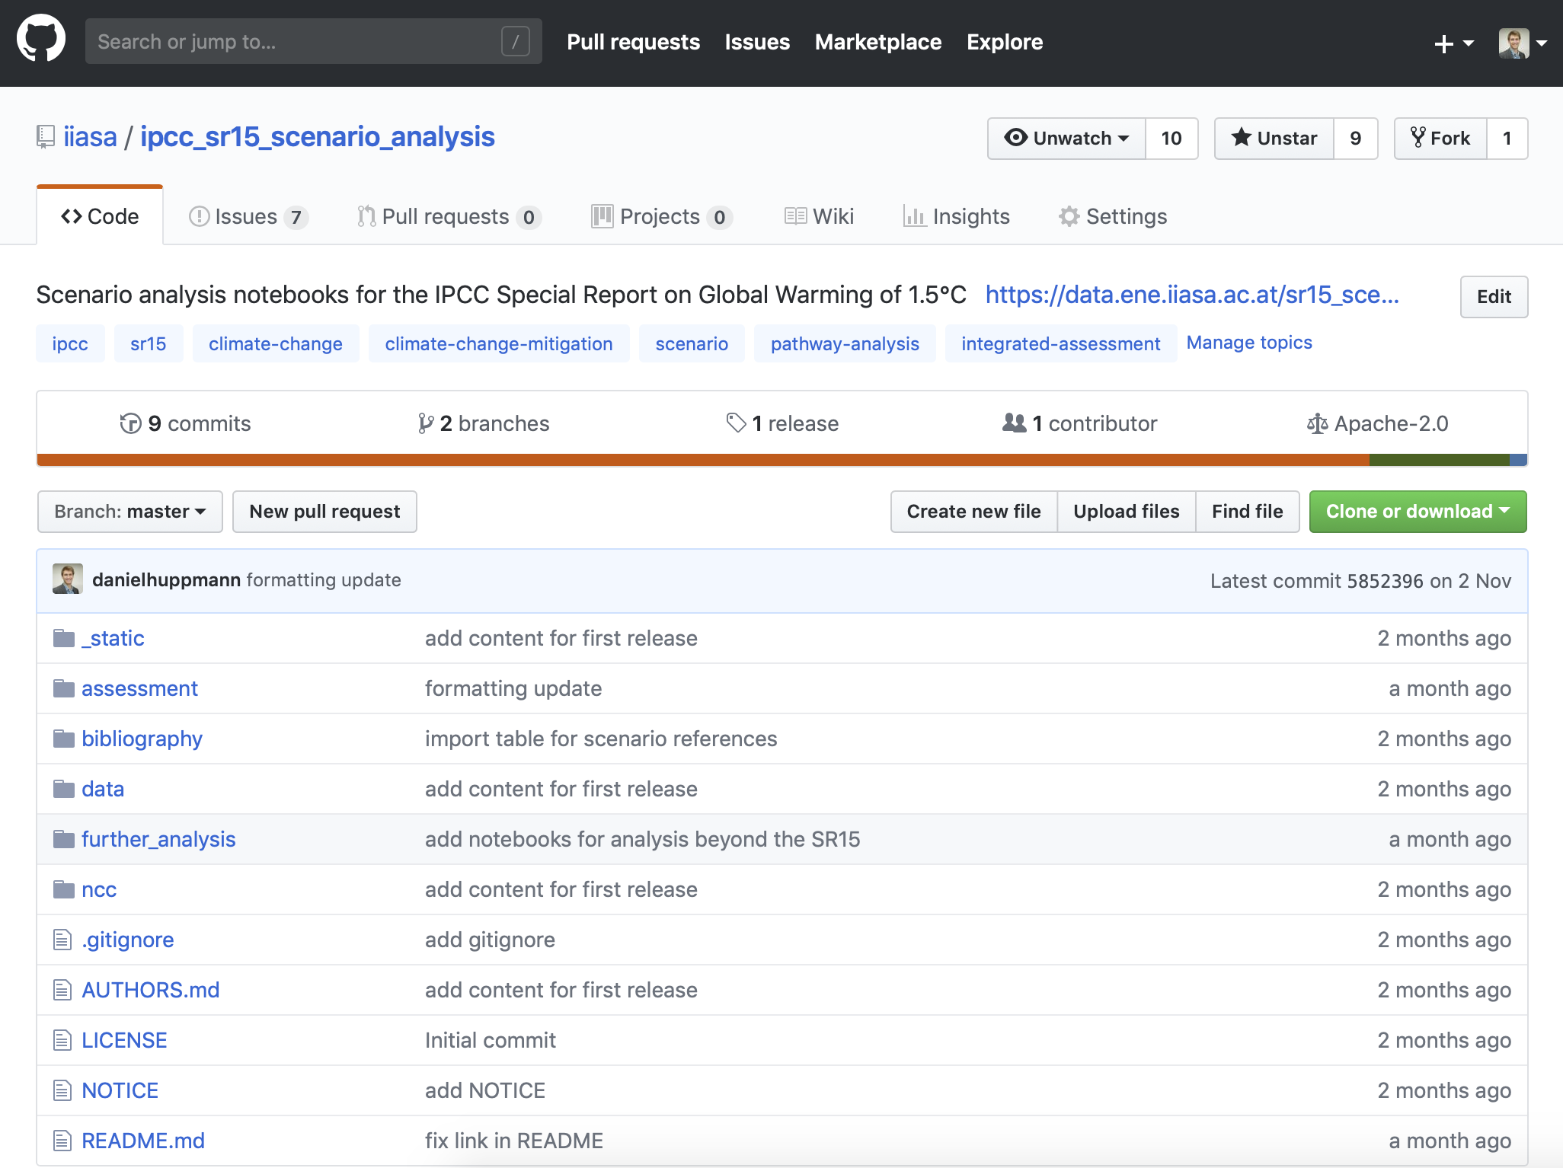
Distribution of scenario assessments via GitHub
Feel free to clone and play around with the analysis notebooks!
$ git clone git@github.com:iiasa/ipcc_sr15_scenario_analysis.git

Slide 40
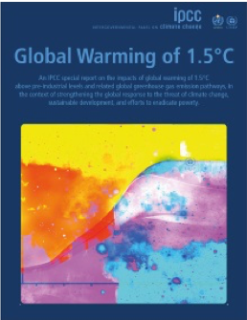
A suite of tools to work with 1.5°C scenarios
Making it easy to dive into the IPCC scenario assessment
A new interactive online scenario explorer: data.ene.iiasa.ac.at/iamc-1.5c-explorer
  Recommended citation of the scenario explorer and data:
  D. Huppmann, E. Kriegler, V. Krey, K. Riahi, J. Rogelj, S.K. Rose, J. Weyant, et al. (2018)
  IAMC 1.5°C Scenario Explorer and Data hosted by IIASA. doi: 10.22022/SR15/08-2018.15429
Assessment and generation of figures & tables using Jupyter notebooks
  Rendered notebooks: data.ene.iiasa.ac.at/sr15_scenario_analysis
  GitHub repository: github.com/iiasa/ipcc_sr15_scenario_analysis
  Based on open-source package pyam: pyam-iamc.readthedocs.io
Description of the process of compiling and assessing
the scenario ensemble, including “do’s and don’ts”
D. Huppmann et al. (2018). A new scenario resource for integrated 1.5 °C research.
Nature Climate Change, 8:1027-1030. doi: 10.1038/s41558-018-0317-4
SR15, IPCC, 2018
Notes:
DOIs

Slide 41
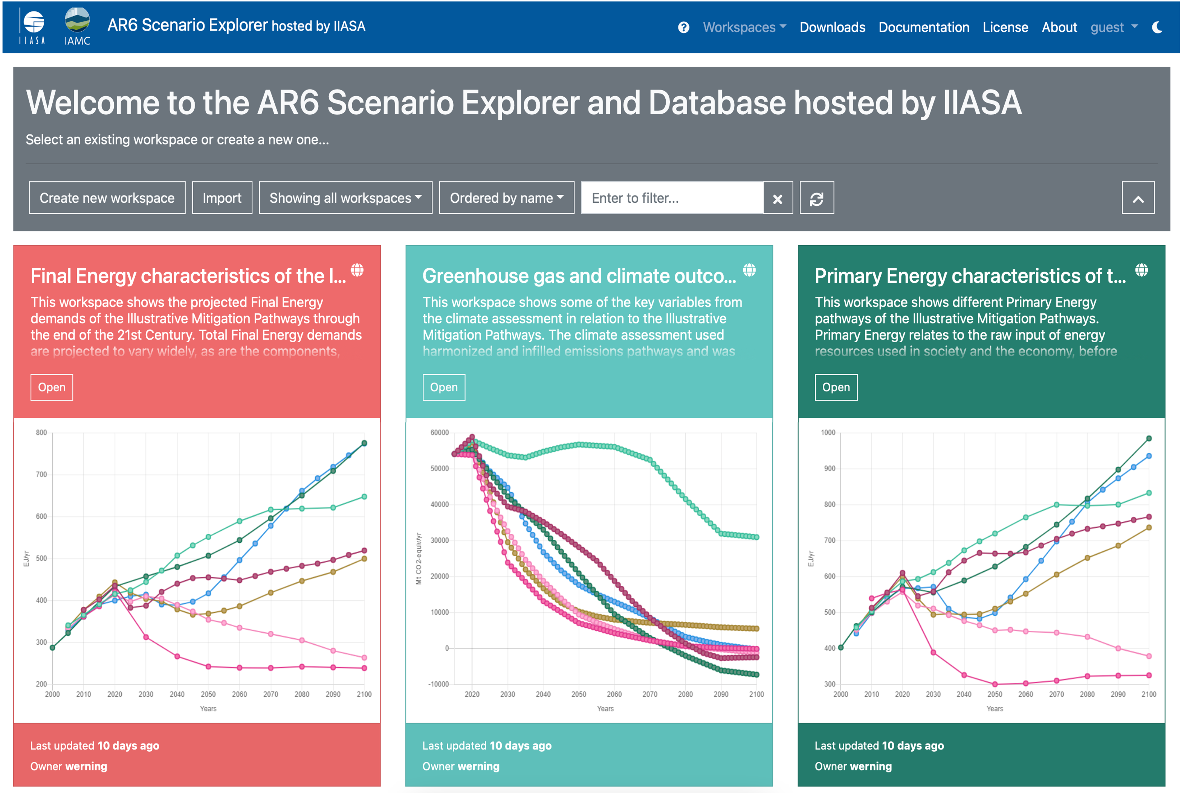
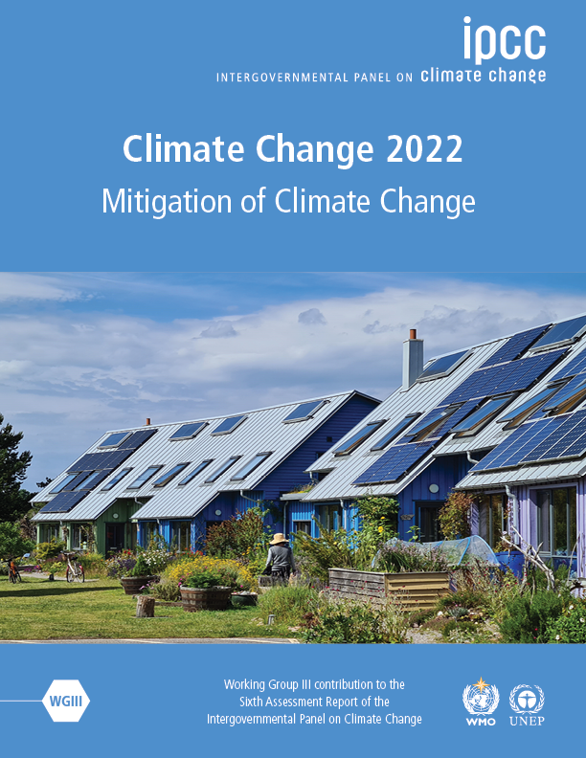
Diving into the scenarios supporting the IPCC AR6
The scenario ensemble supporting quantitative statements of the AR6
was compiled by the IAMC & IIASA on behalf of the IPCC similar to the SR15
Short video on Youtube: https://t.ly/sbrL
IPCC, 2022: Climate Change 2022:
Mitigation of Climate Change.
Contribution of Working Group III
to the Fifth Assessment Report (AR6)
Visit the AR6 Scenario Explorer and Database
at http://data.ece.iiasa.ac.at/ar6

Slide 42

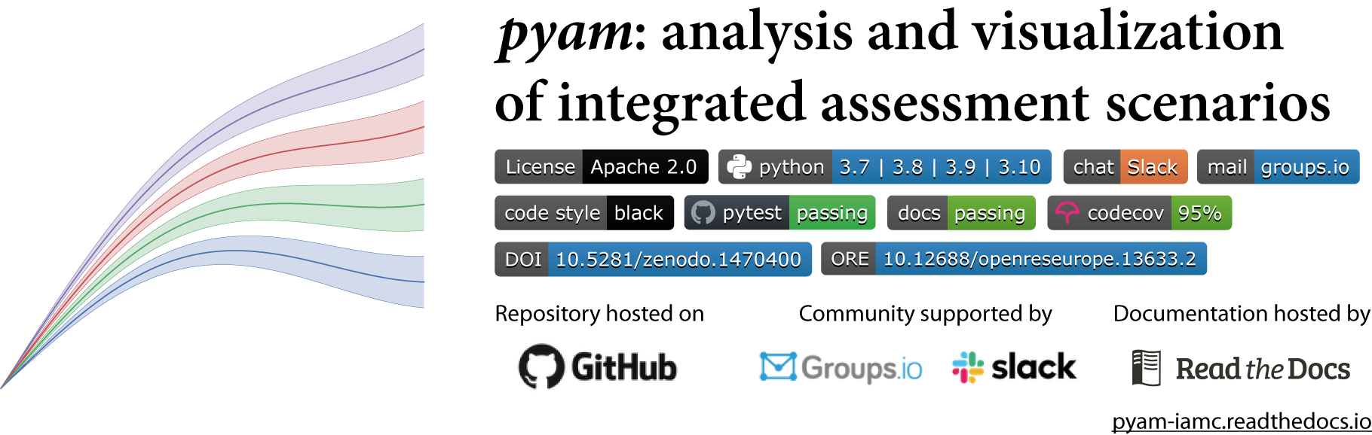



The pyam package
A community package for scenario processing, analysis & visualization
following best practice of collaborative scientific software development
Use cases and features
  Data processing Aggregation, downscaling, unit conversion, I/O to xlsx, csv & frictionless datapackage…
  Validation Checks for completeness of data, internal/external consistency, numerical plausibility …
  Analysis & visualization Categorization and statistics of scenario ensembles, plotting library, …
    Huppmann, Gidden, et al., 2021. Open Research Europe, 1:74 https://doi.org/10.12688/openreseurope.13633.2
#pyam_iamc
pyam-iamc.readthedocs.io
Notes:
The

Slide 43
Homework assignment
Replicate and extend some piece of assessment of the IPCC AR6
Browse through the AR6 Scenario Explorer
Analyse some salient aspect of the scenario ensemble, e.g.,
  Emission trajectories, energy system configuration, ...
  Possibly restricted to particular regions or economic sectors
  Possibly for particular models or projects (CD-LINKS, EMF33, ...)
Create a set of 3-4 figures/tables to illustrate your finding as well as some explanations
  As a Jupyter notebook using `pyam`
  create a new private GitHub repository, invite me as a collaborator when it is ready
  Invitation to collaborate due by Monday, April 24, 23:59

